Slide 1
Protect your Data by Design: Creating a Data Masking Strategy
Christopher Unwin

Slide 2















Please take time to thank our volunteer staff and these sponsors who make this event possible

Slide 3

Christopher Unwin
Previously worked at SIG R&R, PA Consulting Group and Balfour Beatty
Global Solutions Specialist Redgate Software
Co-host of Redgate’s DBAle podcast
/christopherunwincambridge
@RedG_Chris
Christopher Unwin

Slide 4

So is this a ‘vendor session’…?
Actually… no!

Slide 5
Agenda
Why should we be masking data?
How much data are we handling?
Causes of data breaches
What does ‘Data Masking’ do?
Static vs Dynamic
Is it encryption?
How do we start masking?

Slide 6
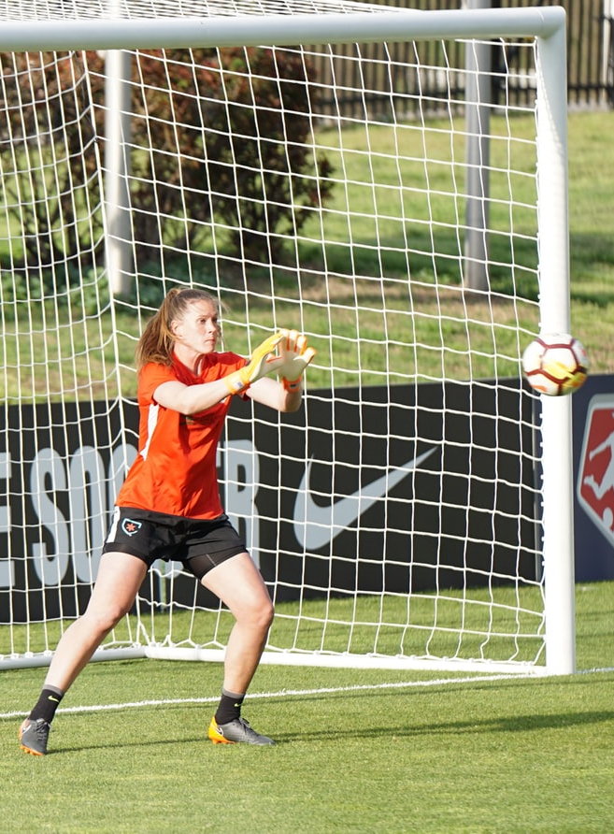
Goal
“To understand not only why it is important to protect data in non-Production environments, but how we can put controls in place to mitigate risk.”

Slide 7
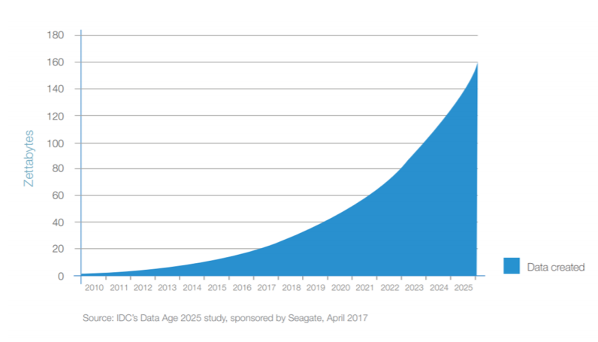
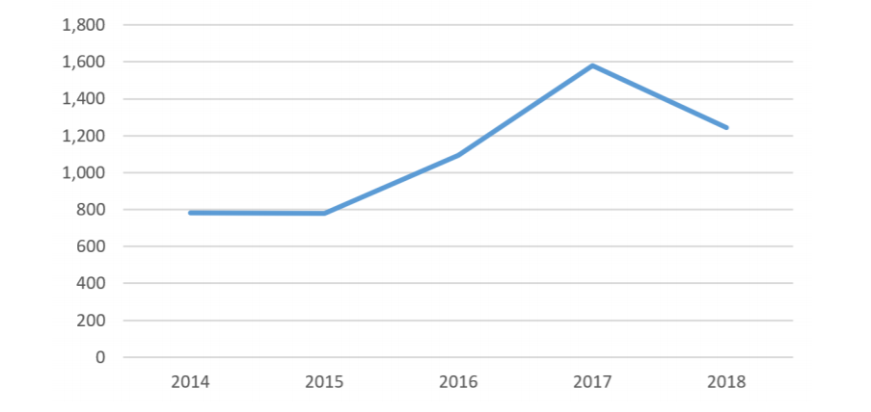
Why do we need to protect data? (1)
Worldwide data handling
Worldwide data breaches

Slide 8


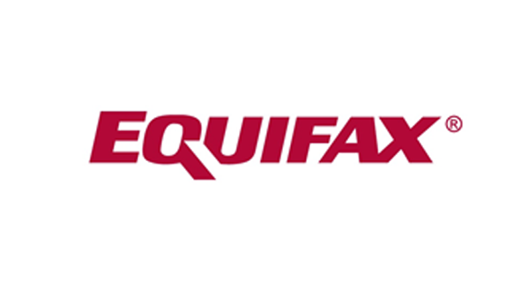


Why do we need to protect data? (2)

Slide 9
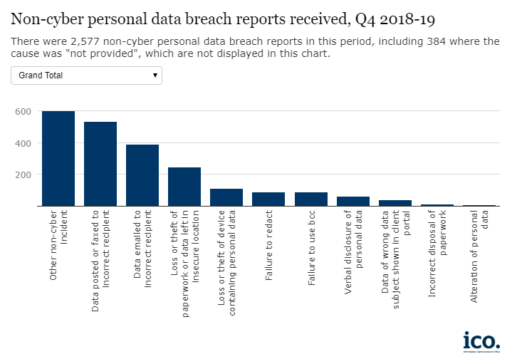
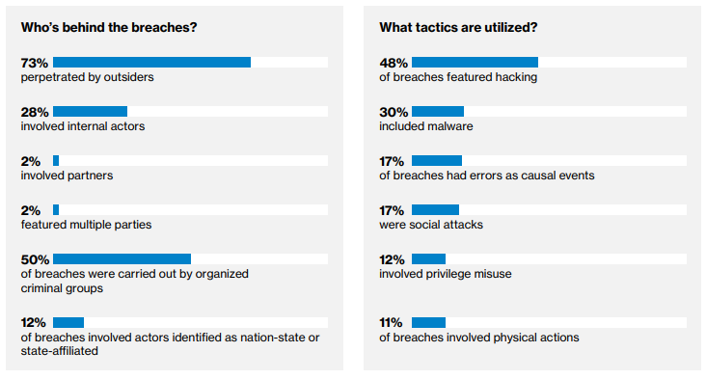
Where do data breaches come from?
ICO Data
Data Emailed to Incorrect Recipient: 392
Loss or Theft of device containing personal data: 112
Failure to Redact: 91
Source: Verizon Data Breach Investigations Report 2018: https://enterprise.verizon.com/resources/reports/DBIR_2018_Report.pdf

Slide 10
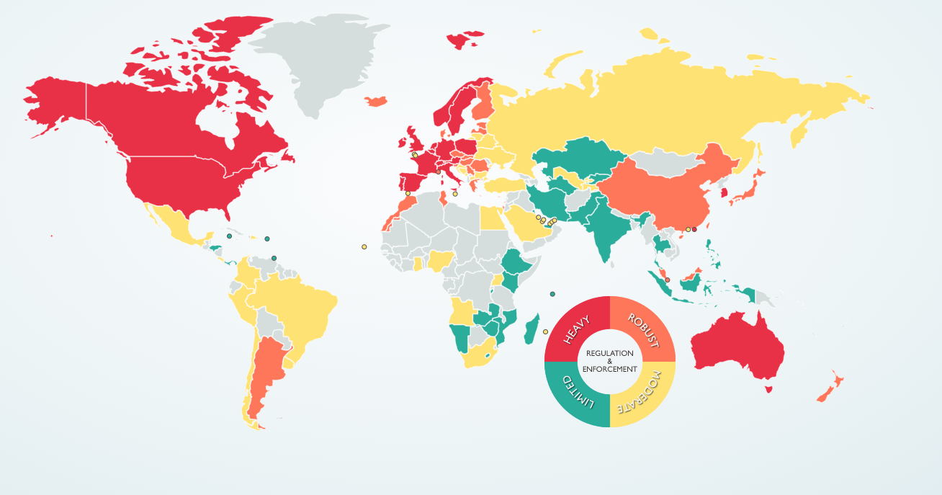





Why do we need to protect data? (3)
Source: DLA Piper - DATA PROTECTION LAWS OF THE WORLD

Slide 11

Regulations have teeth.
Maximum fines:
GDPR: €20m or 4% of total global turnover
LGPD (Brazil): BRL 50m or 2% of global sales revenue
CaCPA: ~$2,500 - $7,500 per capita, dependent on nature of data loss
Fines levied:
British Airways (GDPR): $230m
Anthem (HIPAA): $16m (+$115m Class Action Lawsuit)
Comscore (SOX): $5m + $700k

Slide 12
There’s lots of ways to protect data!
Keep the SQL Server patched & up to date
Control access
Limit numbers of Admins
Disable ‘sa’
Audit failed and successful logins regularly
Enable Encryption
Transparent Data Encryption (TDE)
Row Level Encryption
Always Encrypted
Data Masking

Slide 13
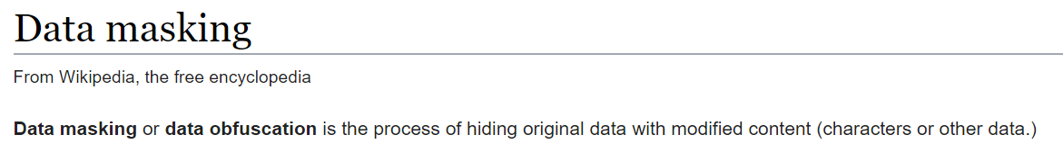
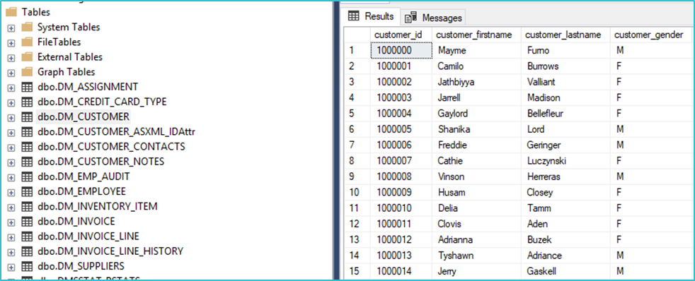
What is Data Masking?

Slide 14

One thing is clear. We must set guardrails.
Notes:
Chris is primary on this section
https://unsplash.com/photos/RzzERMs0McA

Slide 15


1. Control Available Data
(b) collected for specified, explicit and legitimate purposes and not further processed in a manner that is incompatible with those purposes;
(e) kept in a form which permits identification of data subjects for no longer than is necessary for the purposes for which the personal data are processed;
2. Minimize PII Visibility
(c) adequate, relevant and limited to what is necessary in relation to the purposes for which they are processed (‘data minimisation’);
(f) processed in a manner that ensures appropriate security of the personal data, including protection against unauthorised or unlawful processing and against accidental loss, destruction or damage, using appropriate technical or organisational measures (‘integrity and confidentiality’).
https://gdpr-info.eu/

Slide 16
Control available datasets
We want to enable on-demand self service
We do NOT want
Copies of datasets everywhere
Insufficient storage
PII in datasets
Notes:
https://unsplash.com/photos/j6brni7fpvs

Slide 17

Static vs Dynamic Data Masking
Masking
Static:
XYZ
XYZ
Dynamic:
(in MSSQL 2016+)
ABC
XYZ
Masking

Slide 18

Why Static?
Data should be portable; all of the use and none of the risk
3rd party data usage
Off-Shore development
Analytics
Business Intelligence & Profiling
Devs & Testers don’t need real data
There’s lots of places we can go for this…

Slide 19
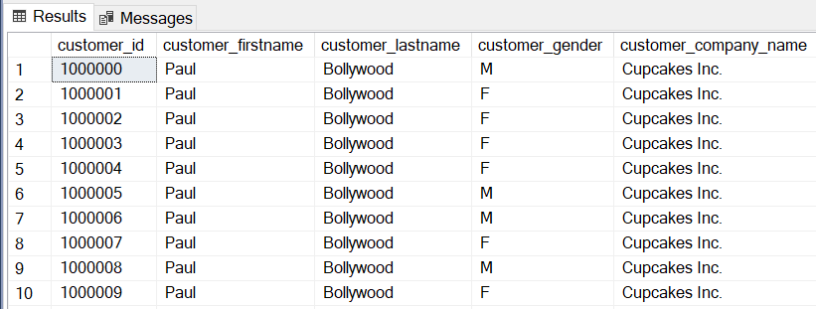
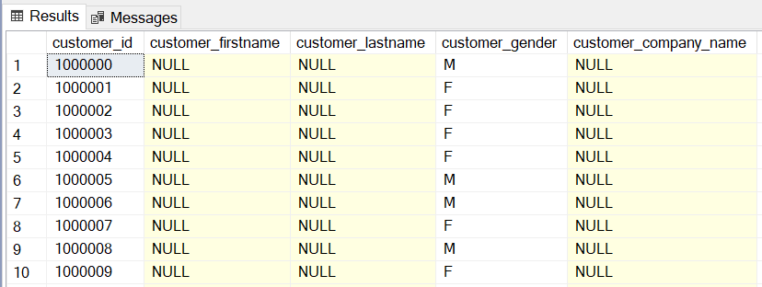
So technically, is this masked?

Slide 20

What do we have to think about first?
?
?
Us
?
Data
Masking
What is so hard about Data Masking?

Slide 21
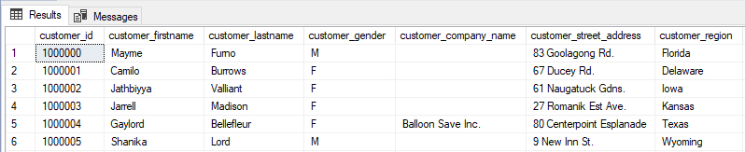
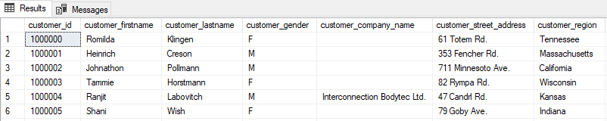
1. We require Realism
It has to look like our data to be realistic for dev & test
We want to use our own sets of data to retain realism
We want to retain the usefulness, demographic and storage profile
NULLs have a part to play
How do we deal with free-text? Remove it all? Use excerpts from a book?

Slide 22

3 (4) words on realism
Use your head (please)

Slide 23
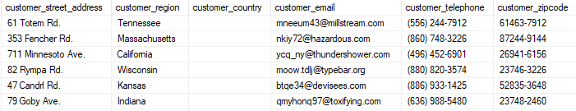
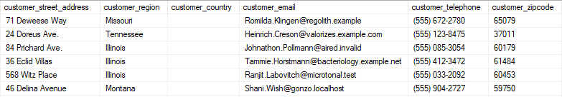
2. Data depends on Data
Not every column exists in isolation from others
Some columns are concatenations of, or are correlated with others
We want data to still validate in test copies of our application like addresses
We want useful email addresses, but don’t want to send anything to a living individual

Slide 24
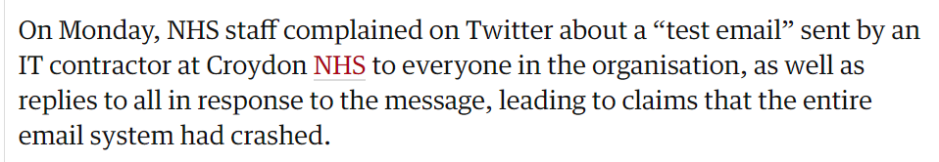
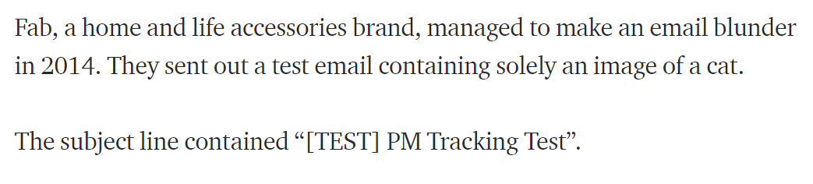

Oops!
Notes:
Sources:
https://www.theguardian.com/society/2016/nov/14/186m-needless-emails-nhs-wide-test-message-and-replies-to-all-crash-system
https://blog.newtonhq.com/6-email-disaster-stories-to-read-before-you-hit-send-8207d9b5dd4e

Slide 25
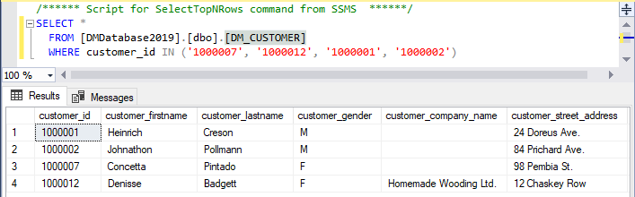
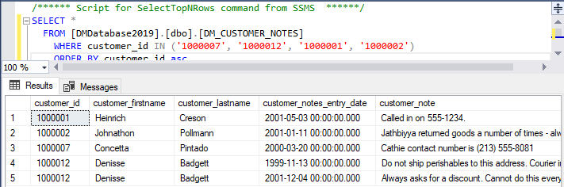
3. Perfect normalization is a dream
Denormalization happens
Data should be consistent across tables where there is duplication
We don’t want to have to set up fresh masks for every column on every table
Once we have masked core tables we should be able to persist this elsewhere

Slide 26
4. It needs to be fast!
There’s no point to any of this if it takes us 14 days to mask 10,000,000 rows!
We must optimize for speed – even if it means trading off resource power
We don’t want to slow down developers by waiting for masking to complete
It is a resource heavy operation and we would prefer everything ran concurrently where possible
Where is any of this happening anyway?
Notes:
https://unsplash.com/photos/Tof1HYnm0LY

Slide 27
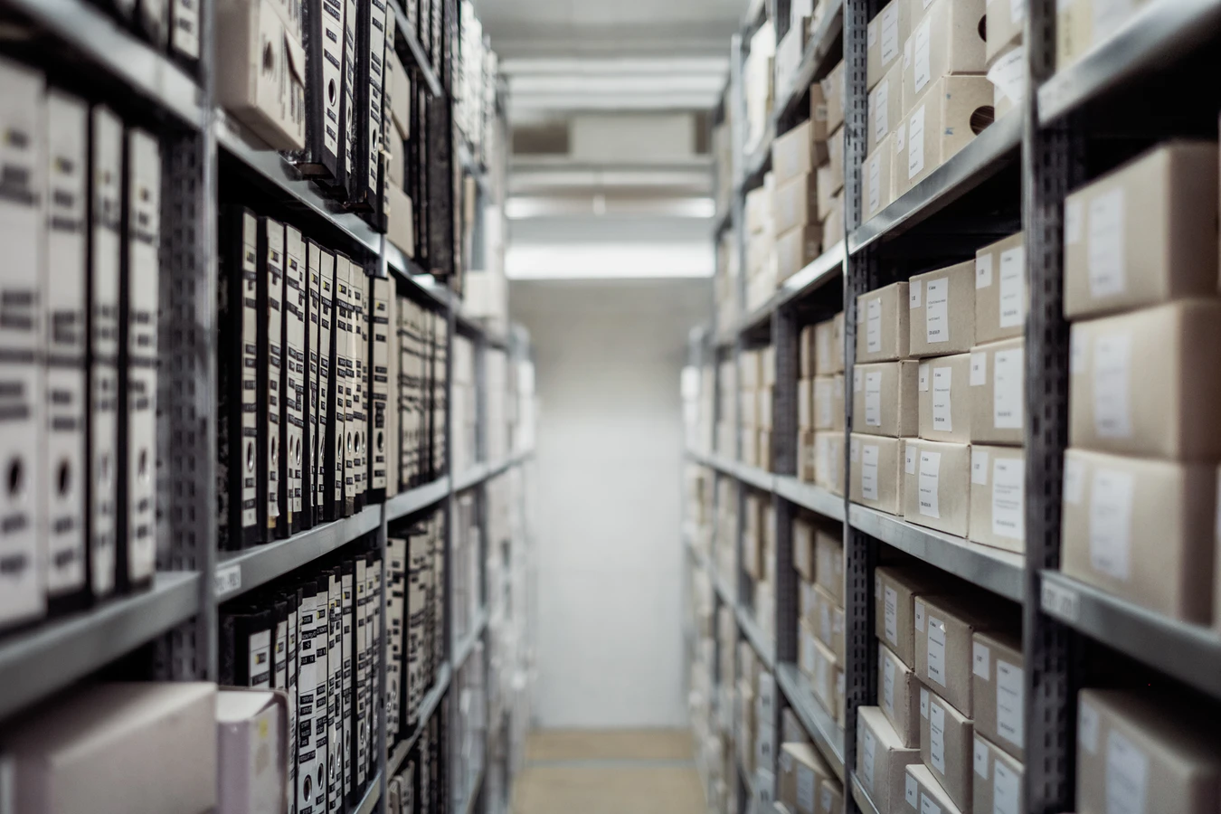
BUT… We can’t mask if we don’t know what we have!

Slide 28
Align people
on data risks

Slide 29

Understand your data first
Identify where your data is
Identify what your data is
Identify where the risk lies

Slide 30
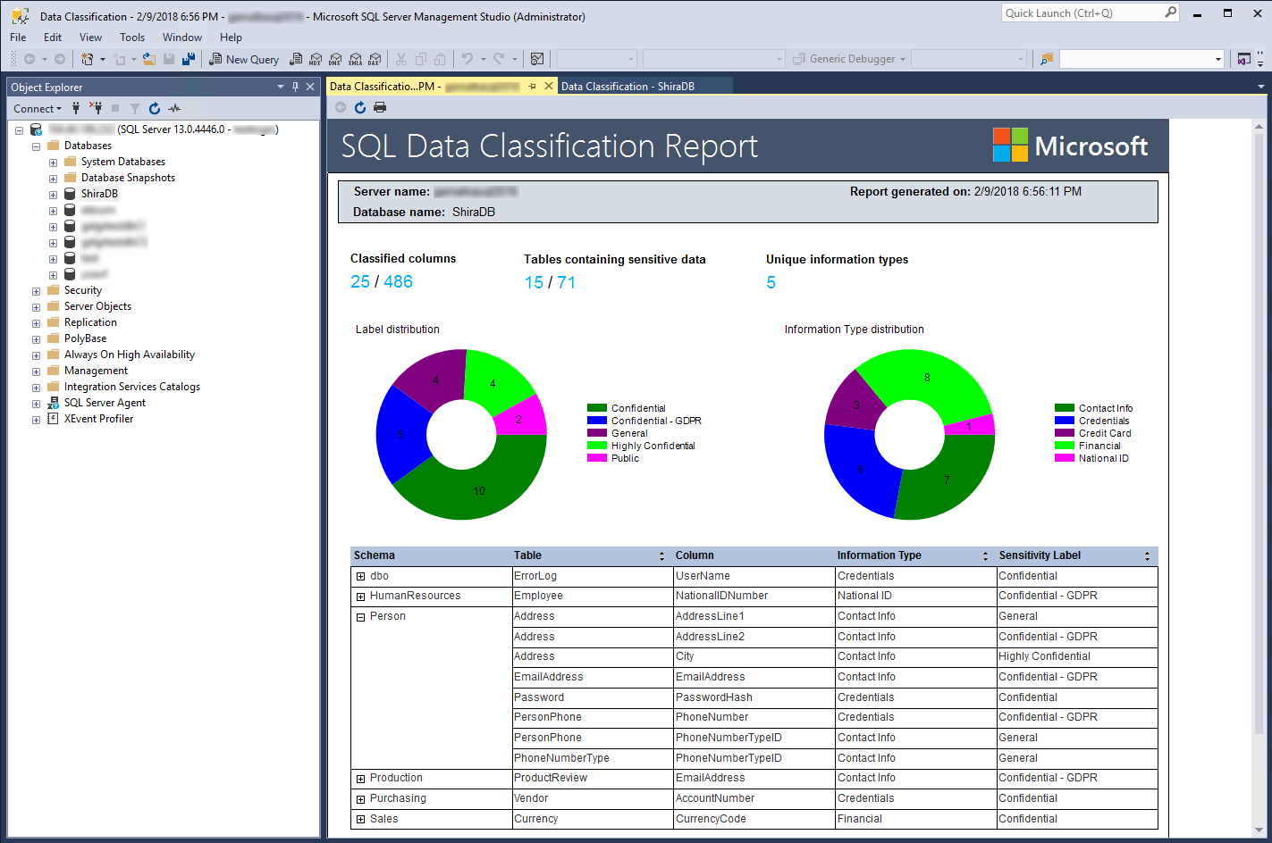
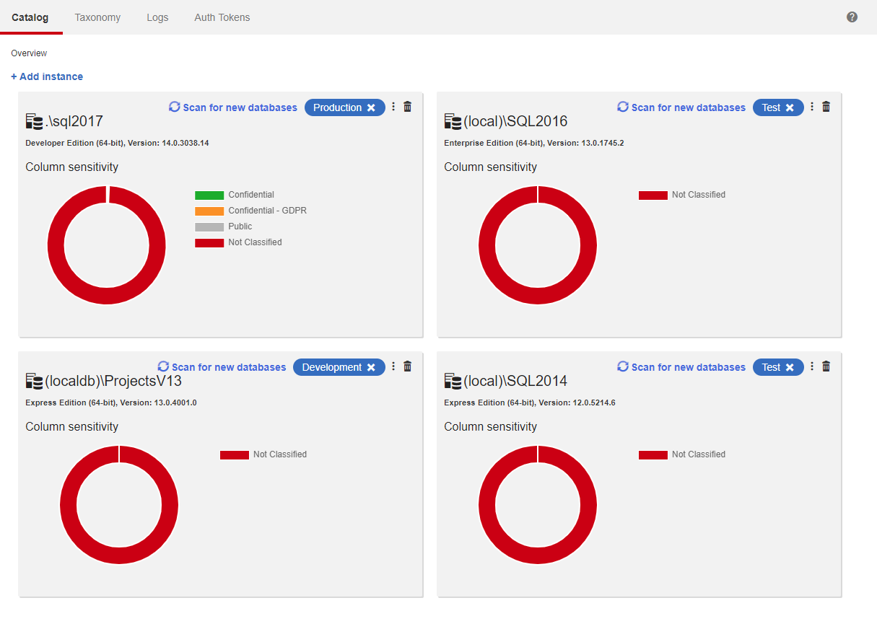
1 - Catalog your data

Slide 31
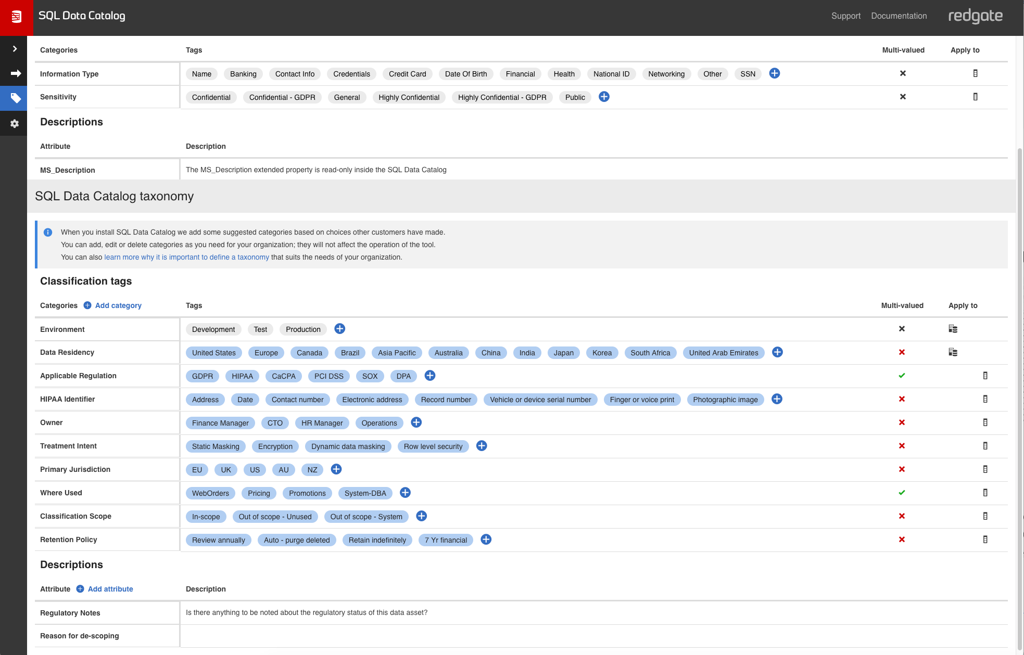
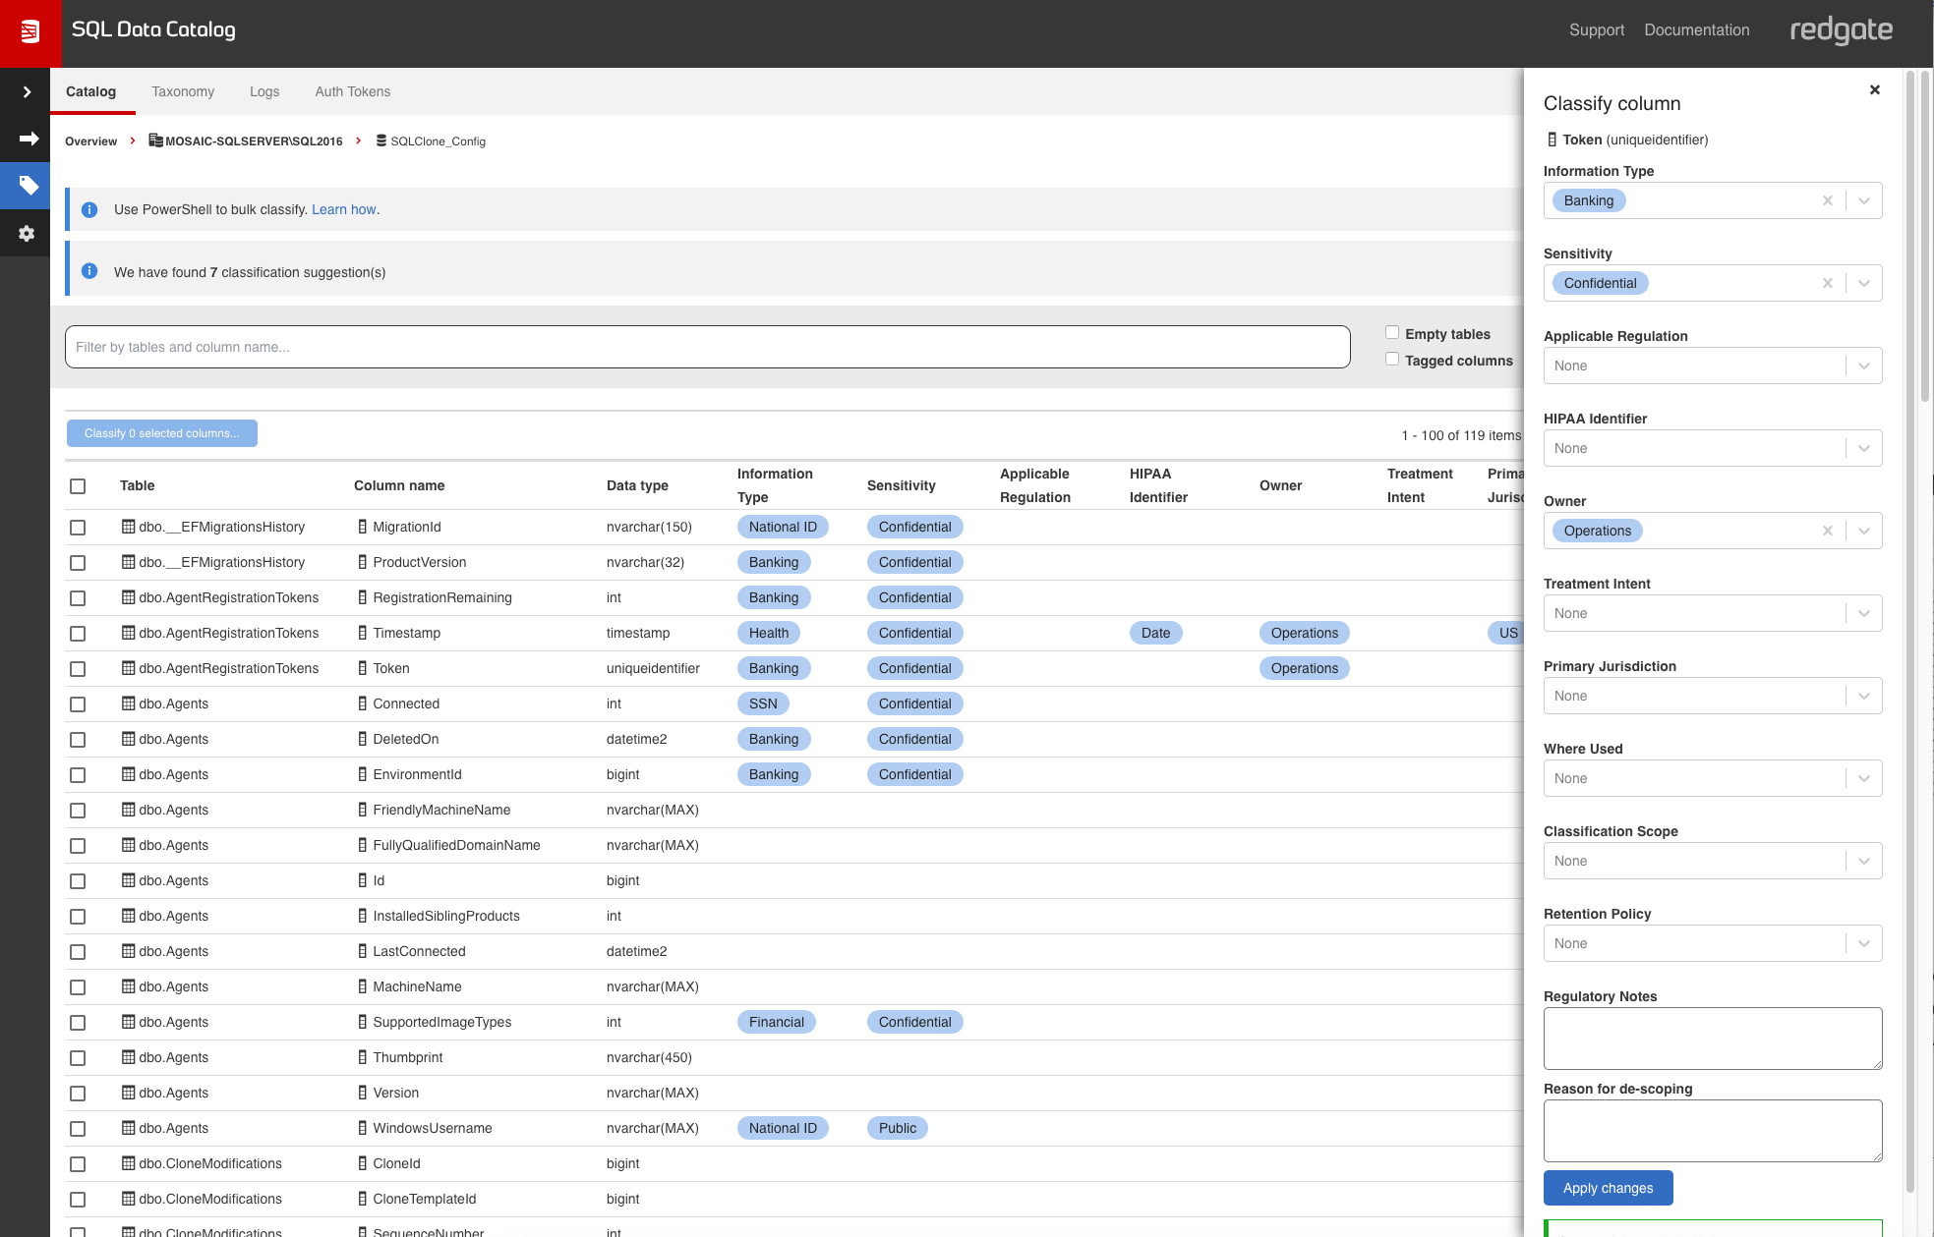
2 - Create a business-wide accepted taxonomy

Slide 32
3 – Use THIS for your decisions
We’re planning to migrate the server, is this a high risk project?
A developer has requested access to the database, can we authorise that?
If we experience a data breach, which systems are the most critical?
Who owns this data? Who’s in charge of keeping it up to date?

Slide 33

4 – Know how data moves
(Data Lineage)
?

Slide 34
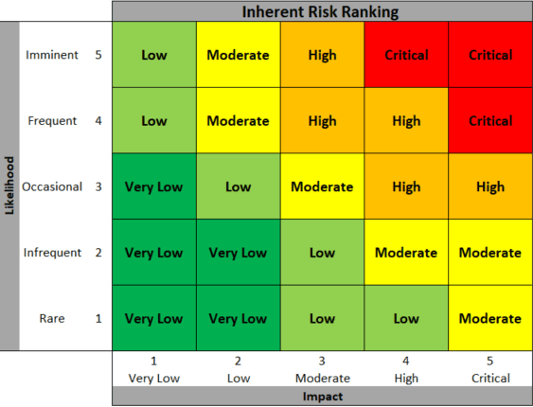
Data Protection Impact Assessments (DPIAs)
Required for processing that is likely to result in a high risk to individuals.
It must:
Describe the nature, scope, context and purposes of the processing;
Assess necessity, proportionality and compliance measures;
Identify and assess risks to individuals; and
Identify any additional measures to mitigate those risks.
Processing activities measured in a risk matrix

Slide 35
Classification in Action

Slide 36
Limit the damage
by knowing the impact

Slide 37
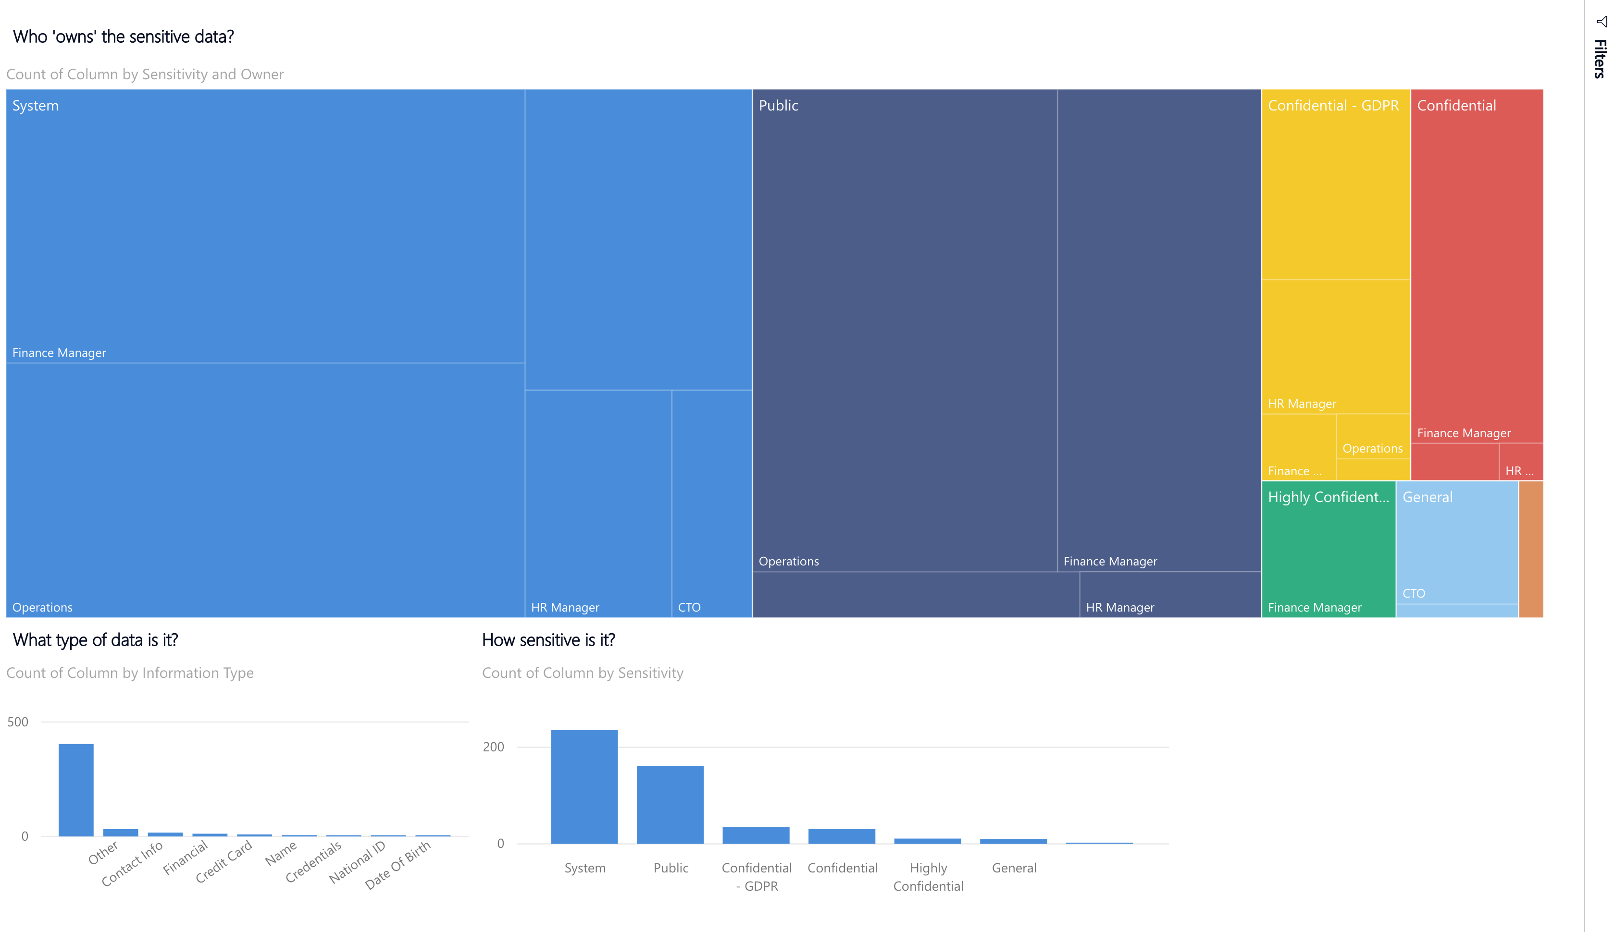

Slide 38

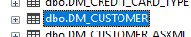
Now we know where the risk is. Let’s protect it
“Starting with YOU!”

Slide 39
Mask once and cascade
DM_Customer
DM_Customer_Notes
DM_Customer_ASXML
DM_Customer_Contacts

Slide 40
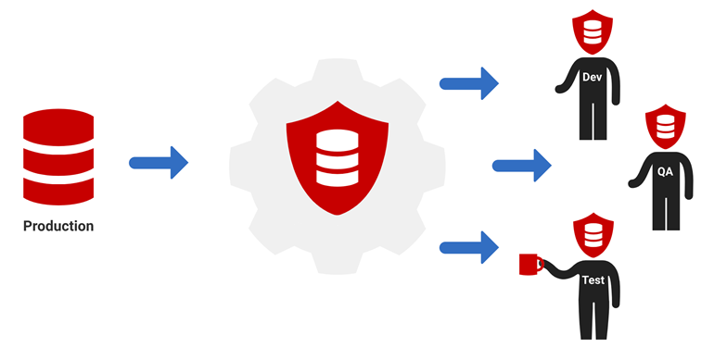
Now let’s get some databases out!

Slide 41
Masking & Provisioning in Action

Slide 42
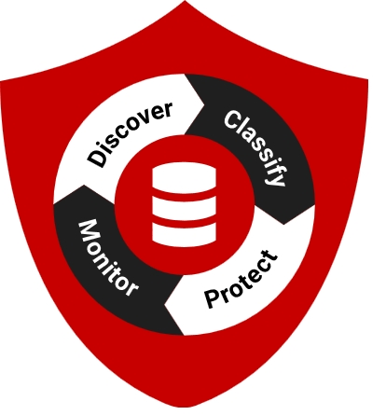
Essential Take-Aways
Where is your data?
What exactly is your data?
Who is accessing your data, and for what purpose?
How can you demonstrate adequate protection?

Slide 43

Questions?
Notes:
https://unsplash.com/photos/j6brni7fpvs

Slide 44
Thank you to our sponsors!

Slide 45

Thank you!
Christopher Unwin
@RedG_Chris
Chris.unwin@red-gate.com
Notes:
https://unsplash.com/photos/j6brni7fpvs

